Slide 2
Azure AI Document Intelligence
Roberto Corella

Slide 3
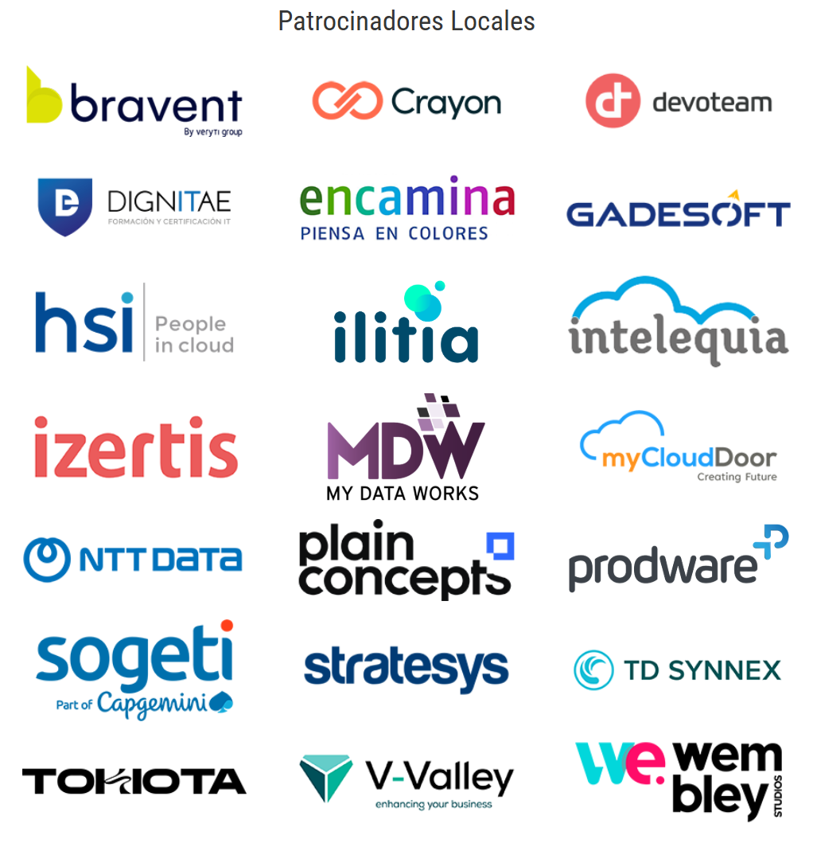



Slide 4








Business Central & Power Platform developer
https://www.linkedin.com/in/robertocorella/
@rccorella
https://www.youtube.com/@rcorella

Slide 5
Azure AI Document Intelligence
Roberto Corella

Slide 6

Agenda
Azure AI Services
Custom Vision Services
Prebuilt models
Using Postman
Using Business Central

Slide 7
Azure AI Services

Slide 8




¿Cuando hablamos de AI en qué piensas?

Slide 9
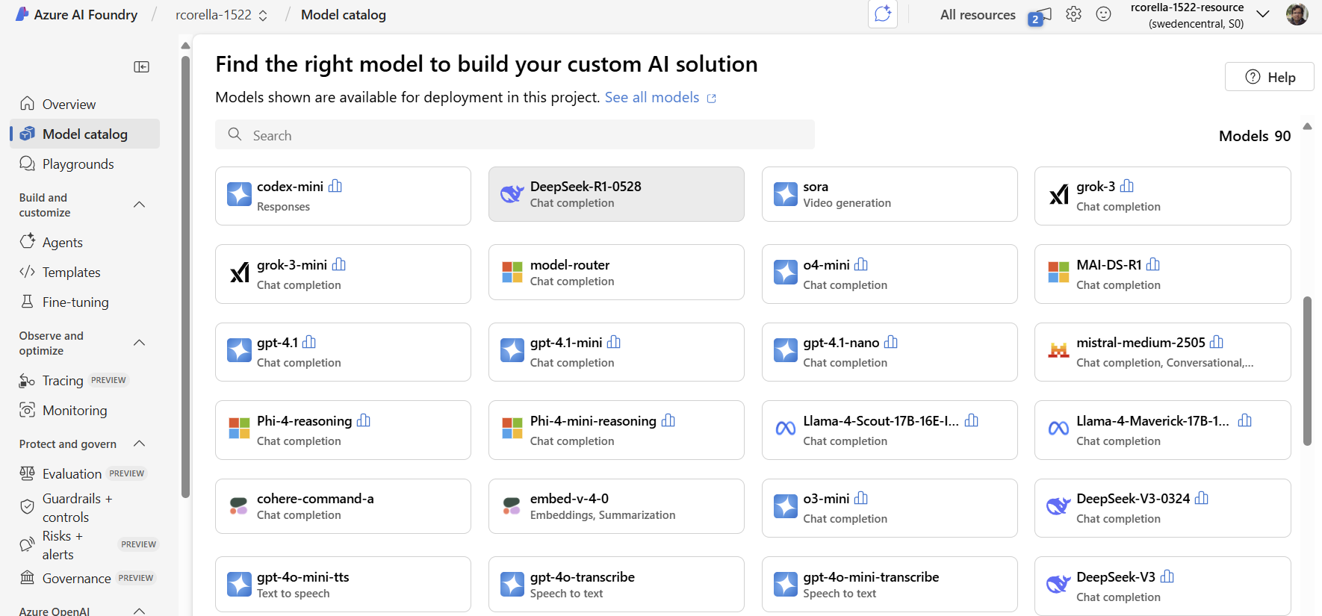

Slide 10
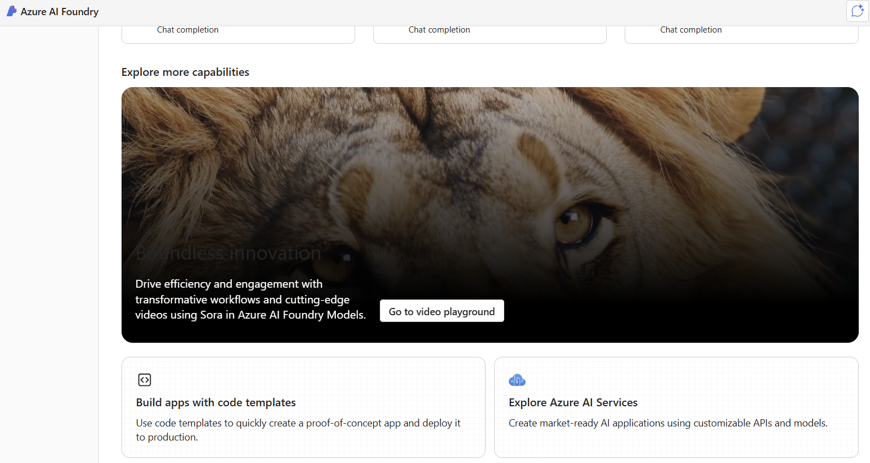

Slide 11










AI is not only Copilot
Azure OpenAI Service
Azure AI Vision
Azure AI Search
Azure AI Speech
Azure AI Document Intelligence
Azure AI Translate
Azure AI Content Safety
Azure AI Language
Azure Machine Learning
Microsoft Azure AI
Where innovators are creating the future

Slide 12
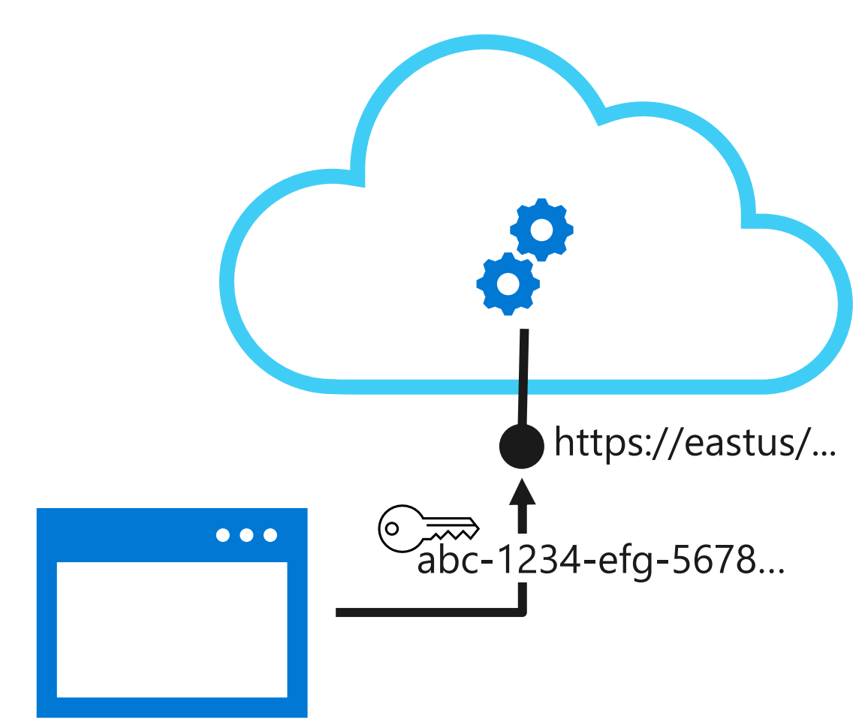
Azure AI Services
They are AI resources available through an Azure subscription
– No need experience in Machine Learning
– Quick to implement
– Tailored for each service: Computer Vision, Translator, Form Recognizer, Anomaly Detector, ...
– Consumed via REST API through a web endpoint
https://learn.microsoft.com/en-us/azure/ai-services/what-are-ai-services

Slide 13
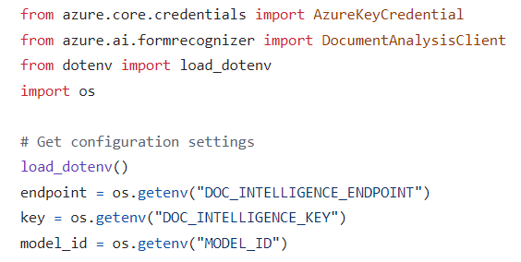
Azure AI Services
You can also use SDK
https://learn.microsoft.com/en-us/azure/ai-services/what-are-ai-services

Slide 14
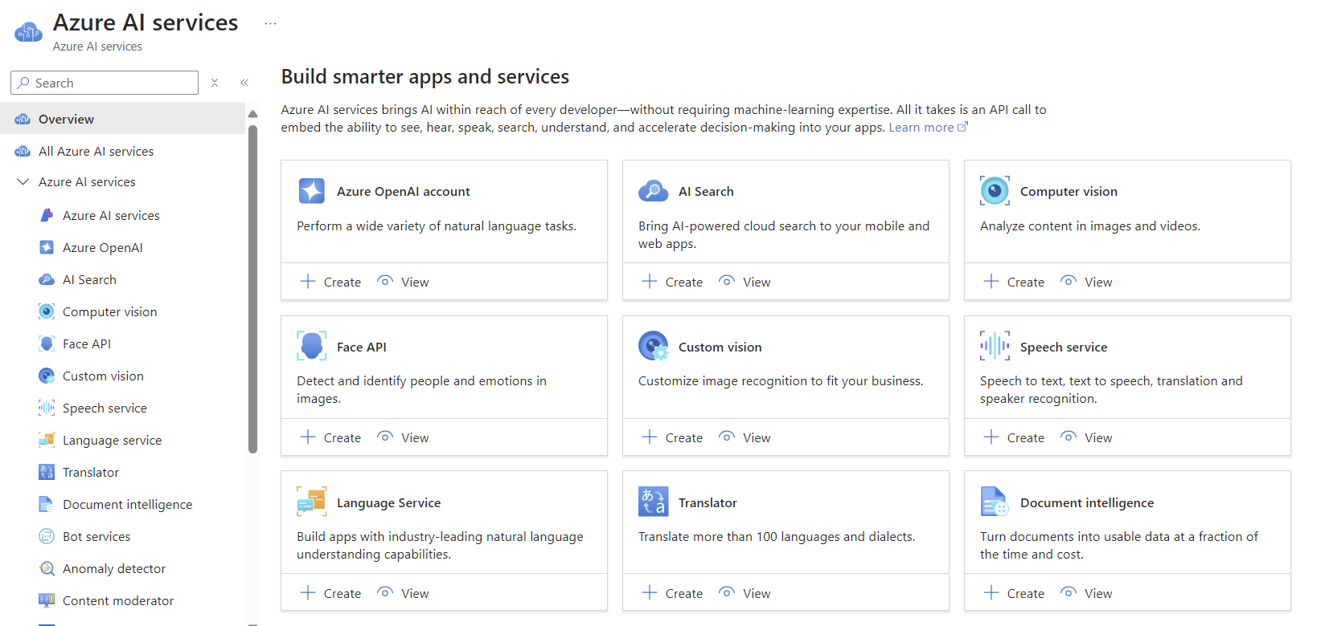

Slide 15
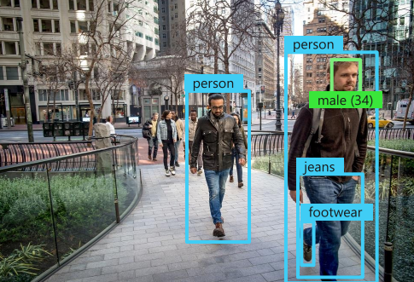
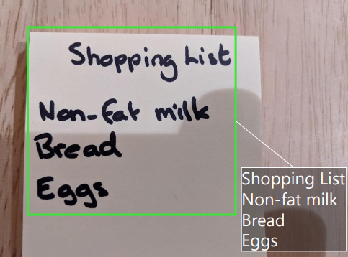
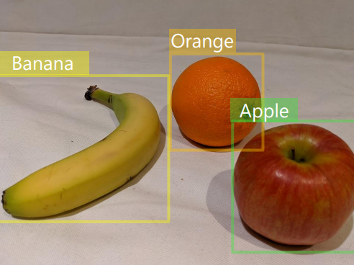
Azure AI Services
Vision Services
Computer Vision
(images)
AI Face
(detect, recognize, and analyze human faces )
Document Intelligence
(Reconocimiento de documentos)

Slide 16
Azure AI Document Intelligence

Slide 17
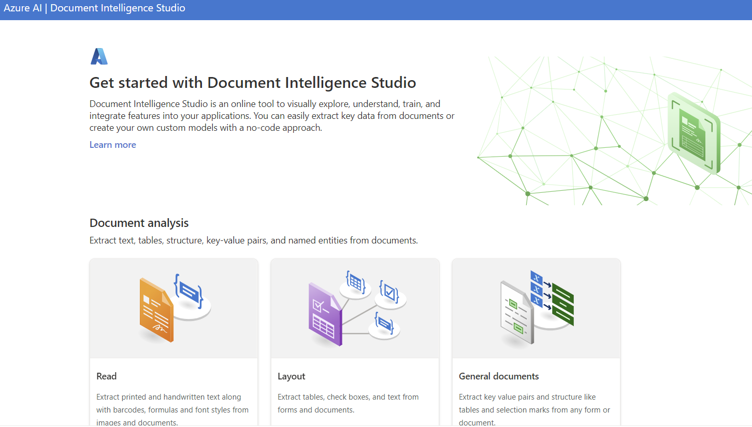

Slide 18
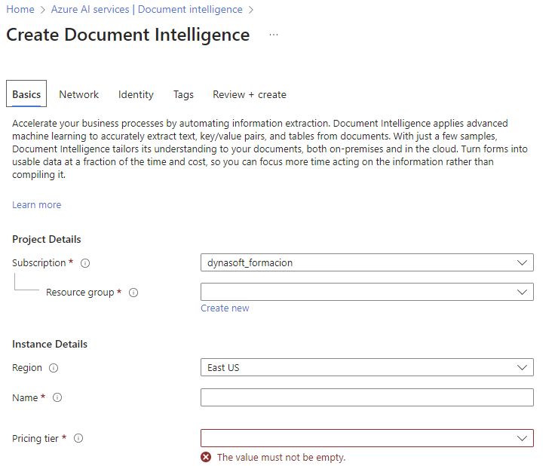

Slide 19
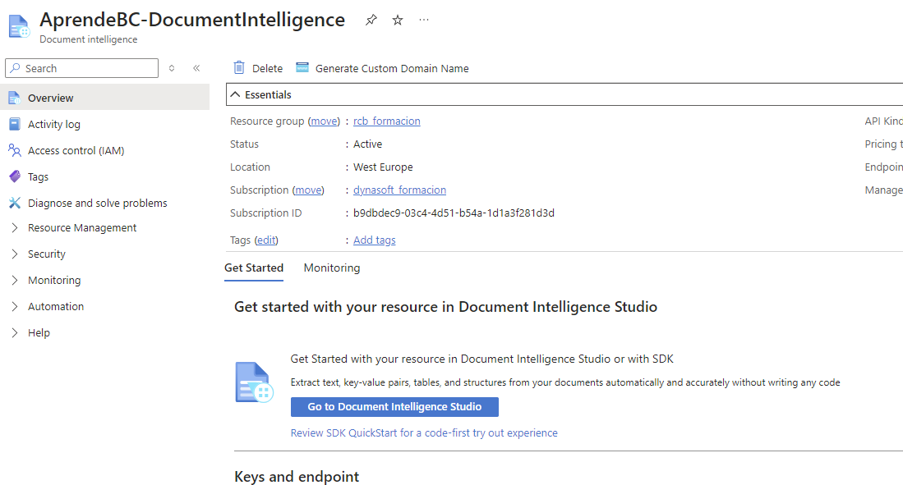

Slide 20
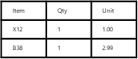
Prebuilt models
Receipt
Invoice
Business Card
Fourth Coffee
Contoso
Fabricam
1/1/2021: 09:34
Invoice No: 1234
Latte 1 $1.29
Cake 1 $2.46
----------
Total: $3.75
Date: 1/1/2021
Hank Zoeng
Sales director
hank@fabrikam.com
555-123-4567
Total: 3.99
Analyze Receipt
Analyze Invoice
Analyze Business Card
Get Analyze Receipt Result
Get Analyze Invoice Result
Get Analyze Business Card Result
{
"MerchantName": "Fourth Coffee",
"TransactionDate": 2021-01-01,
"TransactionTime": 09:34,
"Items" [
...],
"Total": 3.75
}
{
"VendorName": "Contoso",
"InvoiceNumber": 1234,
"InvoiceDate": 2021-01-01
"Tables" [
...],
"TotalInvoiceAmount": 3.99
}
{
"ContactNames": [
{
"FirstName": "Hank",
"LastName": "Zoeng"
}],
...
}

Slide 21
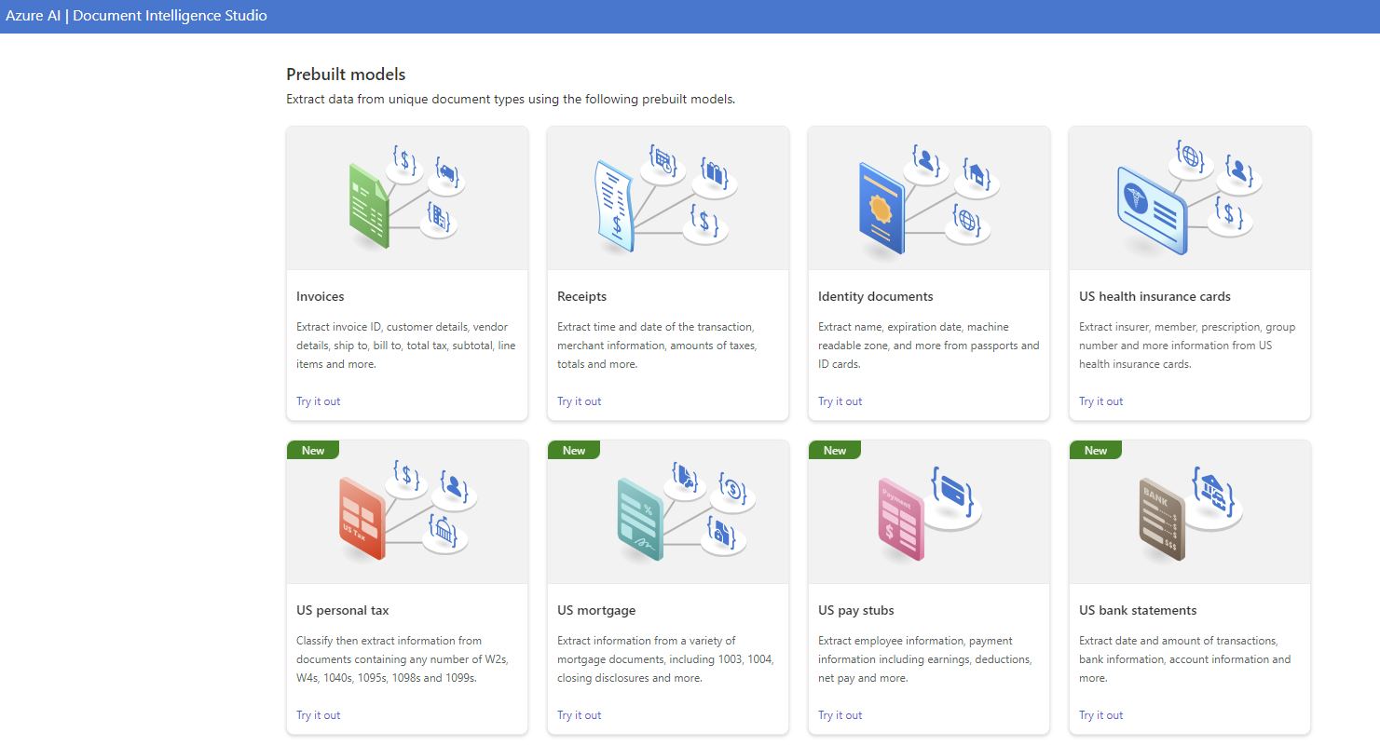
Extract data from unique document types using the prebuilt models
Prebuilt Models

Slide 22
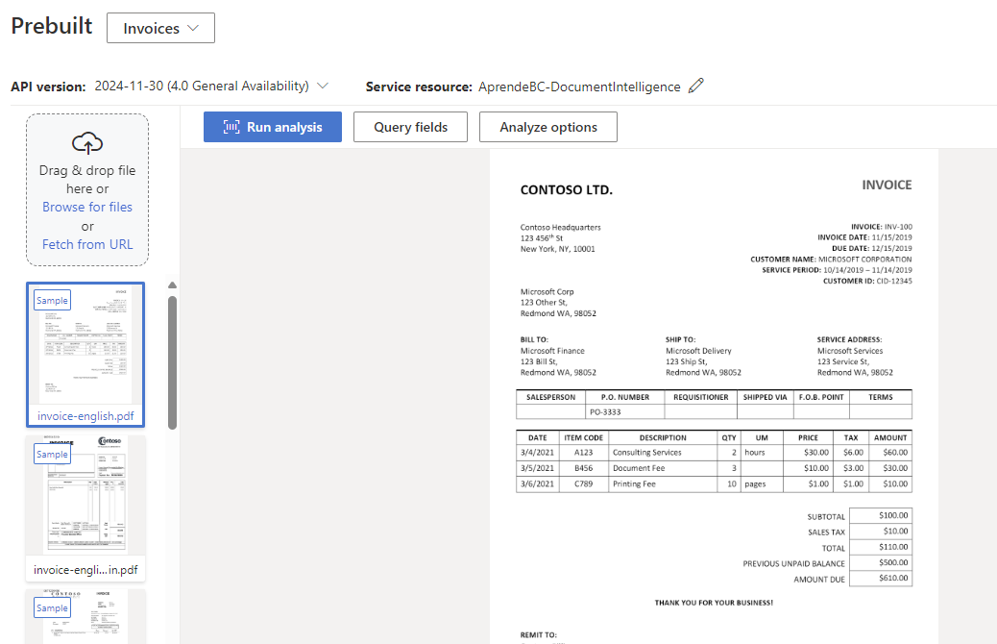
Prebuilt Models: Invoices

Slide 23
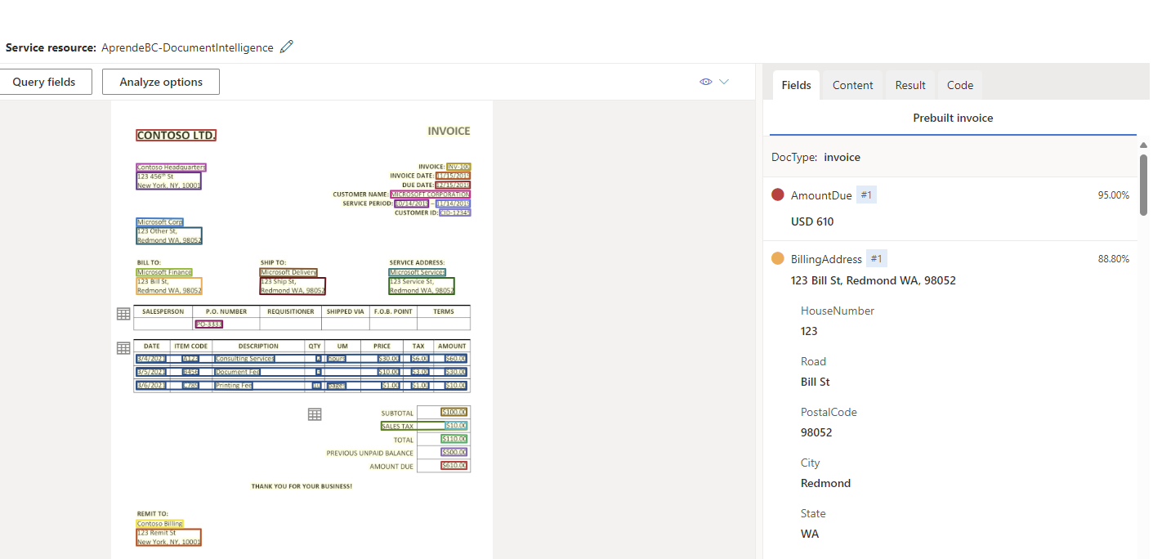
Prebuilt Models: How it works

Slide 24
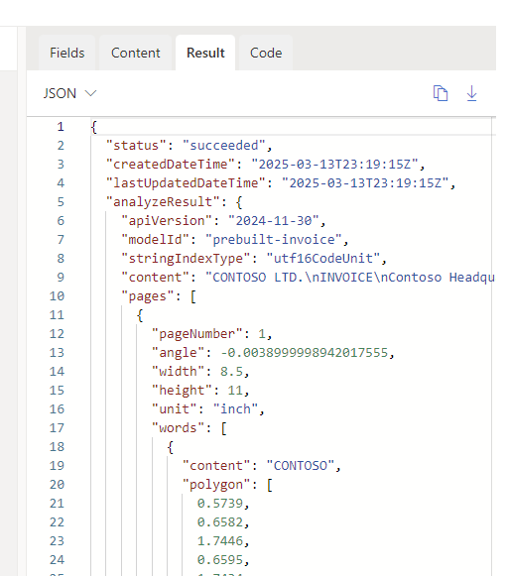
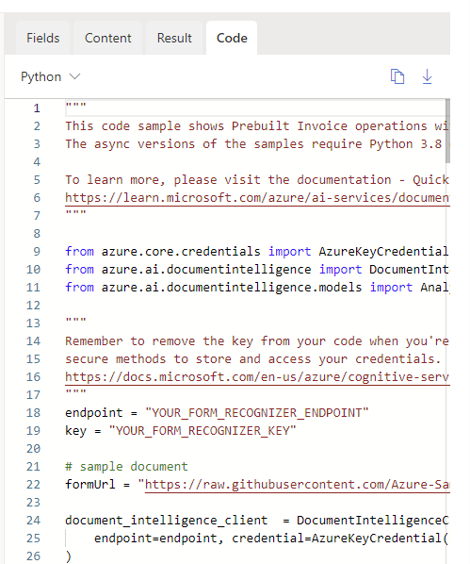
Prebuilt Models for Developers

Slide 25
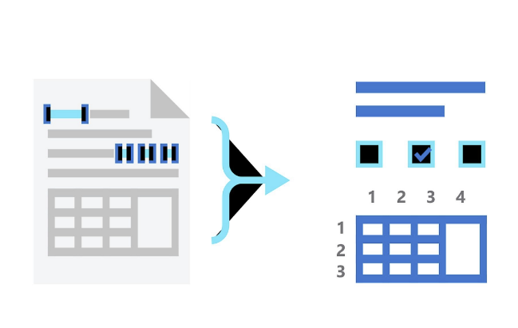
DEMO

Slide 26
Azure AI Foundry

Slide 27
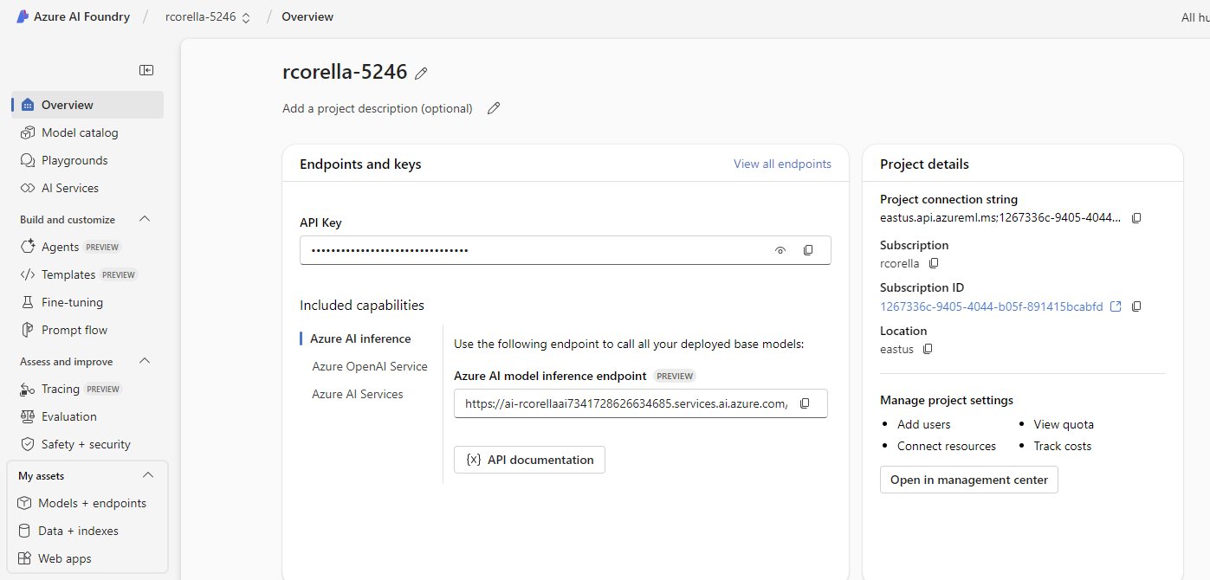
AI Foundry

Slide 28
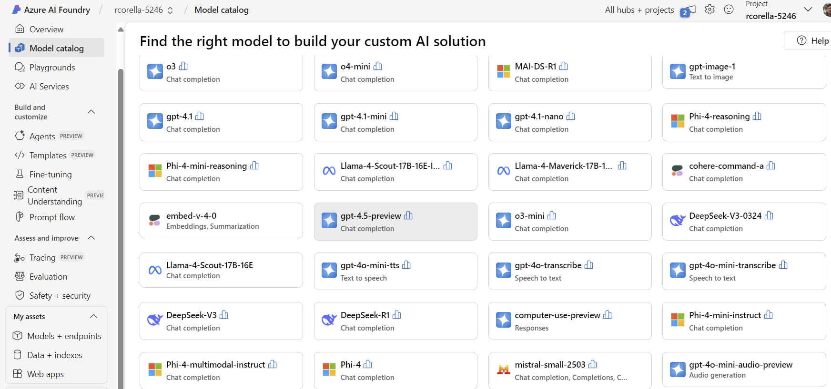
AI Foundry

Slide 29
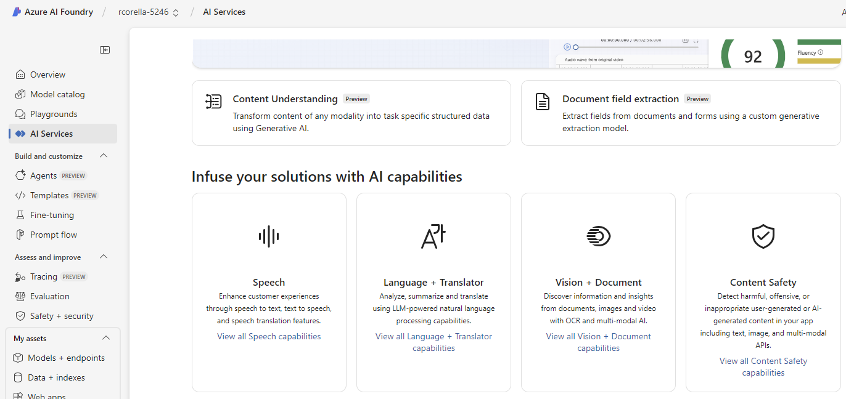
AI Foundry: AI Services

Slide 30
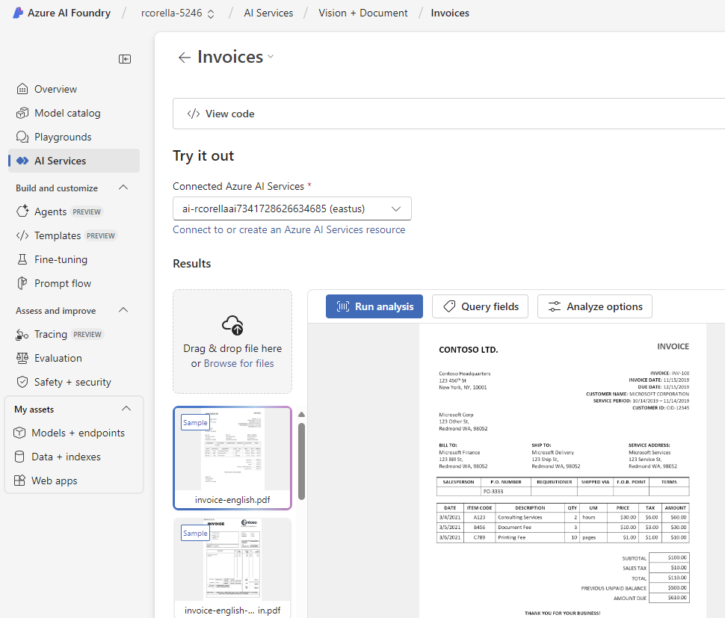
AI Foundry

Slide 31
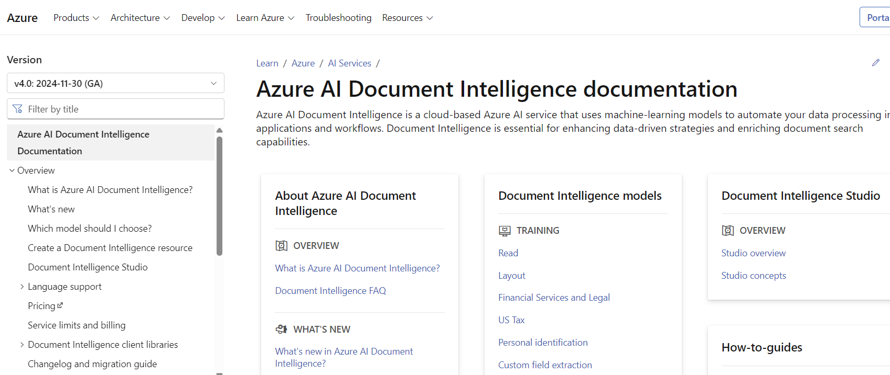
Using the Azure AI Documents: API

Slide 32
Consuming Azure AI Document Intelligence

Slide 33
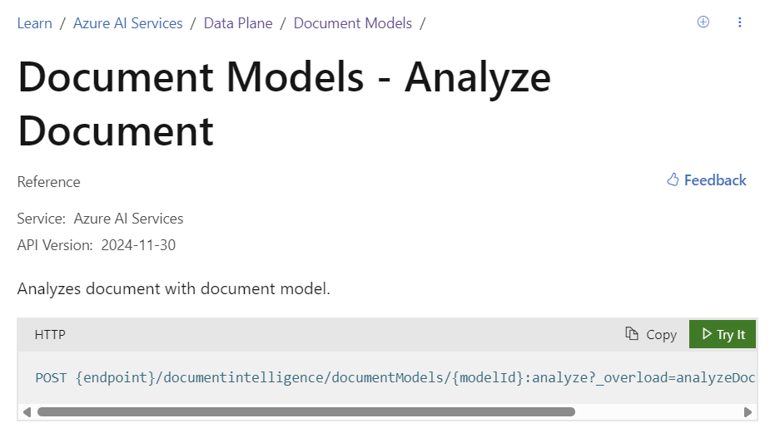
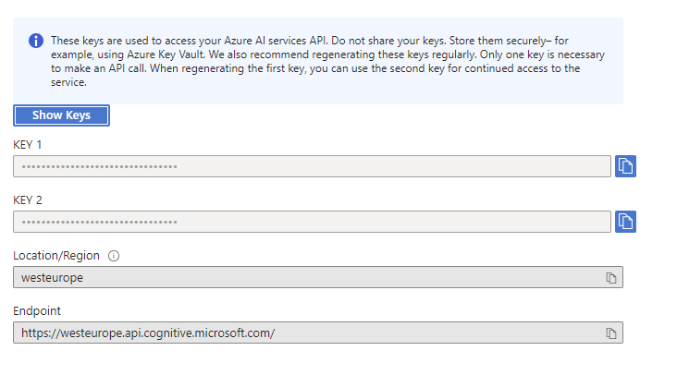
Using the Azure AI Documents: API
https://learn.microsoft.com/en-us/rest/api/aiservices/document-models?view=rest-aiservices-v4.0%20(2024-11-30)
https://learn.microsoft.com/en-us/rest/api/aiservices/document-models/analyze-document?view=rest-aiservices-v4.0%20(2024-11-30)&tabs=HTTP

Slide 34

Using the Azure AI Documents: How it works?
Step 1:
We send the document to Azure AI Document

Slide 35


Using the Azure AI Documents: How it works?
Step 2:
We read the analyzed document.

Slide 36
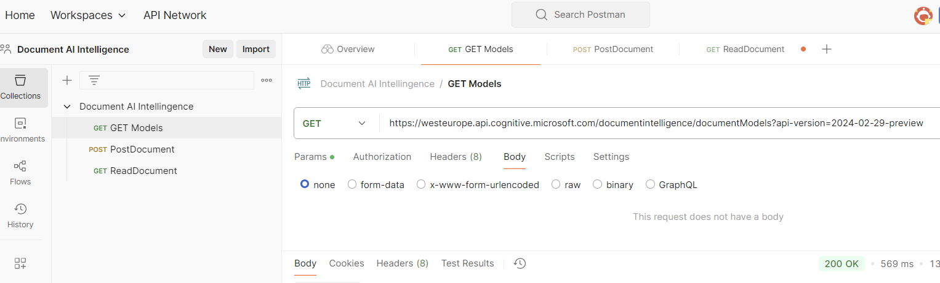
Using the Azure AI Documents: API
1 – POST sending a document
2 – GET reading de information

Slide 37
Consuming Azure AI Document Intelligence in Business Central

Slide 38
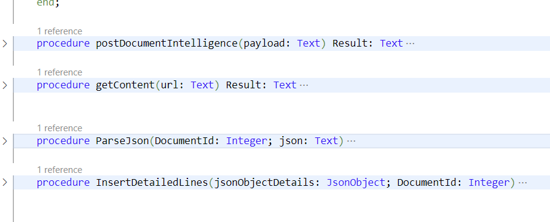
DEMO Invoices BC

Slide 39
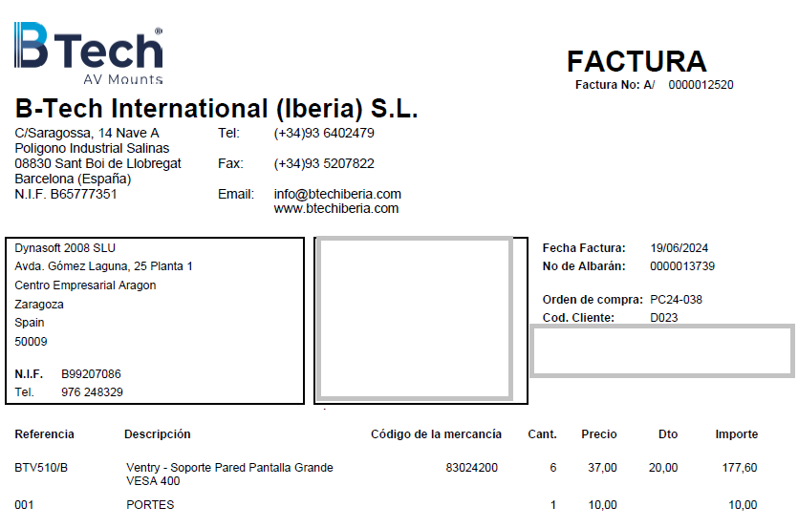
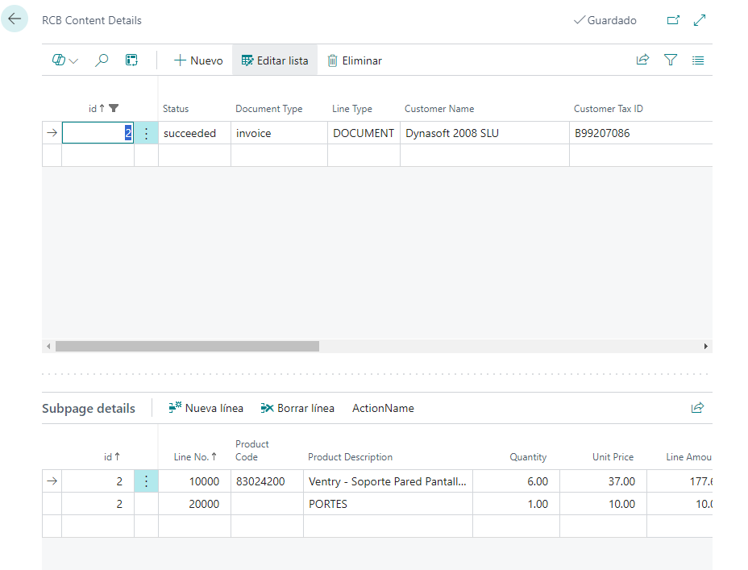
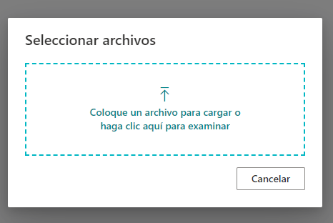
DEMO Invoices BC

Slide 40
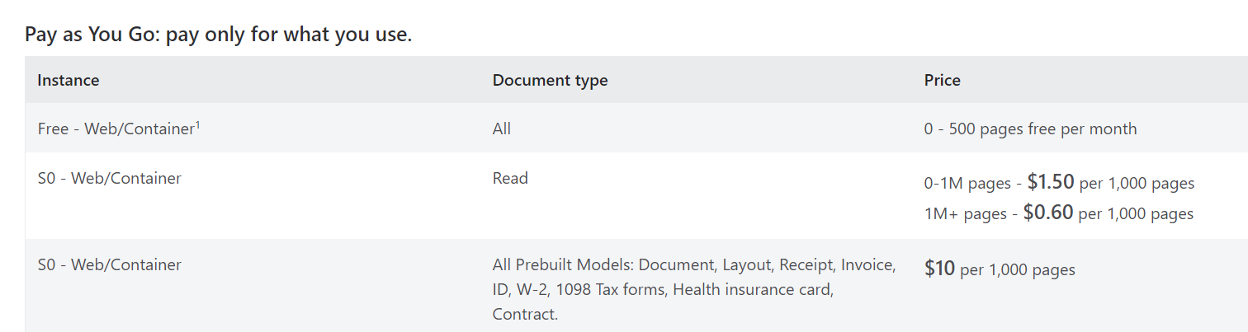
Prices

Slide 41
Take aways
Use the whole Microsoft Ecosystem
Learn about the AI Services
Test your own documents (no PhD necessary): it is free ☺
Consuming you Azure AI document

Slide 42
Thanks
https://www.linkedin.com/in/robertocorella/
@rccorella
https://www.youtube.com/@rcorella

